Slide 1
U.S. Tape Kapro Tools Product Offering Focus and Training
2024

Slide 2
BOX LEVELS

Slide 3
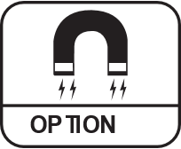
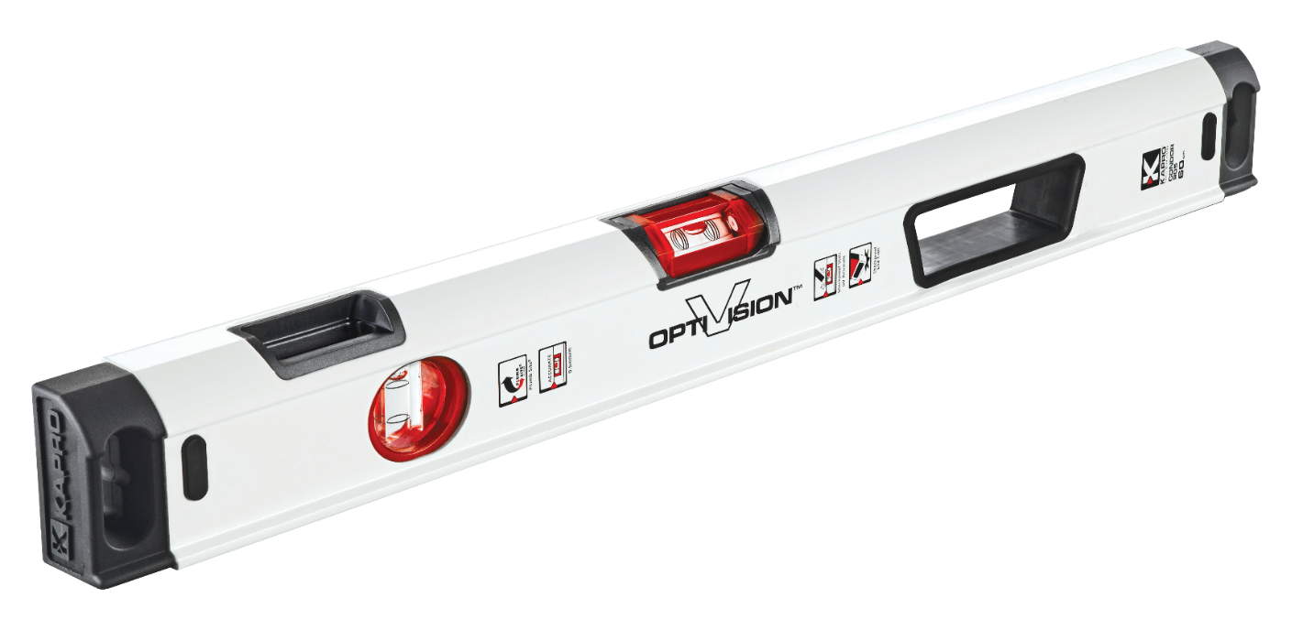
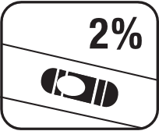
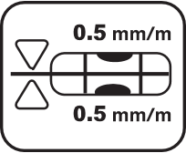
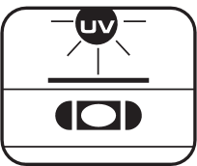
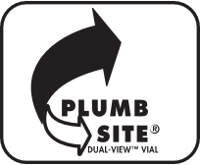
905 CONDOR™
The Professional Box Level With OPTIVISION® Red
BOX LEVELS
Type | BOX
Accuracy | ±0.5mm/m (±0.0005 in/in)
Length | 24″ | 48″ | 72″
Vials | 2 vials – 1 Horizontal OPTIVISION® Red + 1 Plumb Site®
Special Features | • Bridge at horizontal vial for increased body strength • Continuous marking surface • Wall-grip • Ergo Grip™ rubber handle • Shock-absorbing rubber end caps

Slide 4
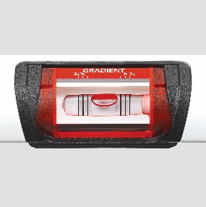
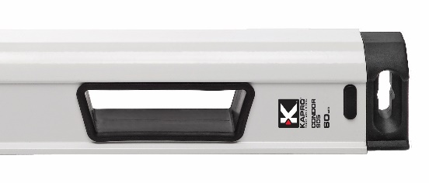
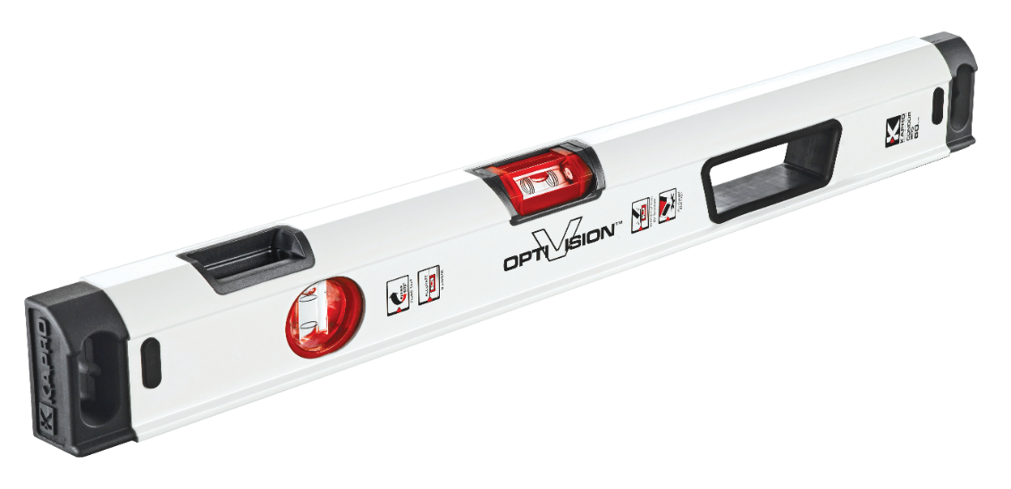
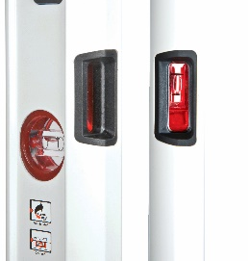
905 CONDOR™
The Professional Box Level with OPTIVISION® Red
Ergo Grip™ rubber handle
Tiling/Drywall
OPTIVISION® Red tilted horizontal vial with gradient lines up to 2%
BOX LEVELS
Masonry
Plumb Site® Dual-View™ vial
Framing

Slide 5
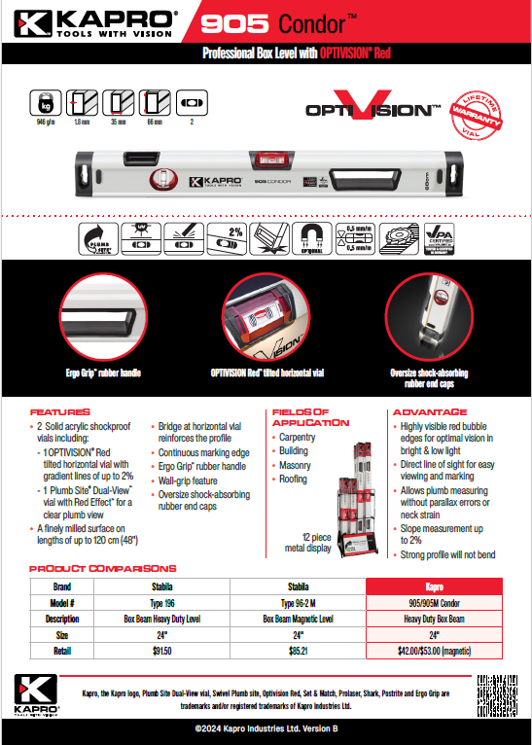
905 CONDOR™
BOX LEVELS

Slide 6
985 XL APOLLO™
Heavy-Duty Professional Box Level
BOX LEVELS
Type | BOX
Accuracy | ±0.5mm/m (±0.0005 in/in)
Length | 16″ | 24″ | 32″ | 36″ | 48″ | 58″ | 72″ | 78″ | 96″
Vials | 3 vials – 1 Horizontal + 1 Vertical + 1 Plumb Site®
Special Features | • Ergo Grip™ non-slip handle • Shock-absorbing rubber end caps

Slide 7
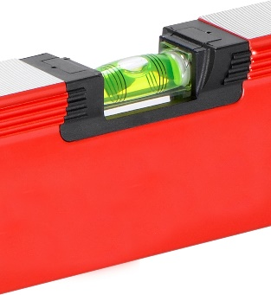
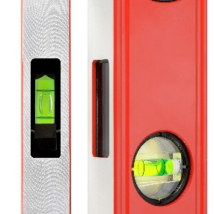
985 XL APOLLO™
Heavy-Duty Professional Box Level
Plumb Site® Dual-View™ vial
Framing
Magnified horizontal vial with gradient lines up to 2%
BOX LEVELS
Masonry
Ergo Grip™ non-slip handle
Tiling

Slide 8
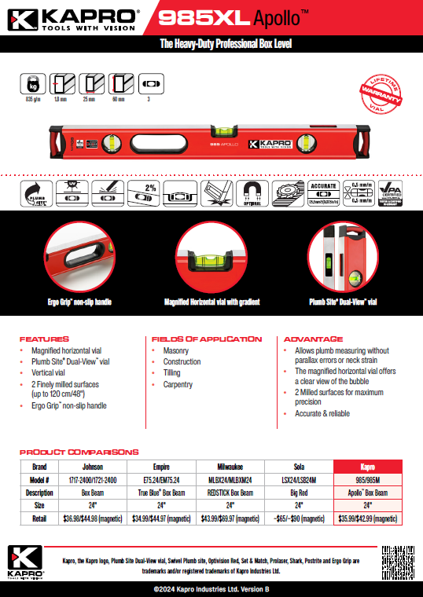
985 XL APOLLO™
Heavy-Duty Professional Box Level
BOX LEVELS

Slide 10
DIGITAL LEVELS

Slide 11
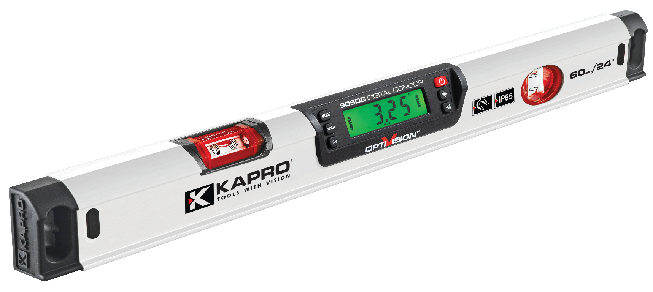
905DG DIGITAL CONDOR™
BOX LEVELS
Type | BOX
Accuracy | <0.05° at level & plumb - <0.2° at other angles
Length | 24″| 48″| 72″
Vials | 2 vials – 1 Horizontal OPTIVISION® Red + 1 Plumb Site®

Slide 12
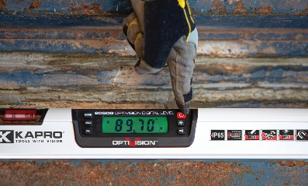
905DG DIGITAL CONDOR™
Digital accuracy:
0.05° at level & plumb
0.2° at other angles
Drywall
OPTIVISION® Red tilted horizontal vial with gradient lines up to 2%
DIGITAL LEVELS
Masonry
Plumb Site® Dual-View™ vial
Trim Work/Cabinetry

Slide 14
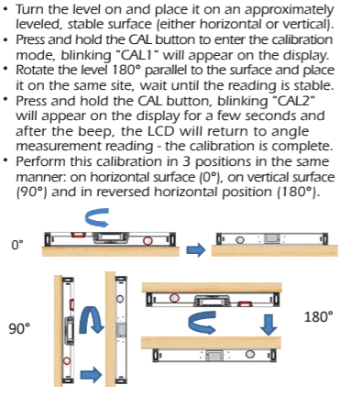
905DG DIGITAL CALIBRATION
BOX LEVELS

Slide 15
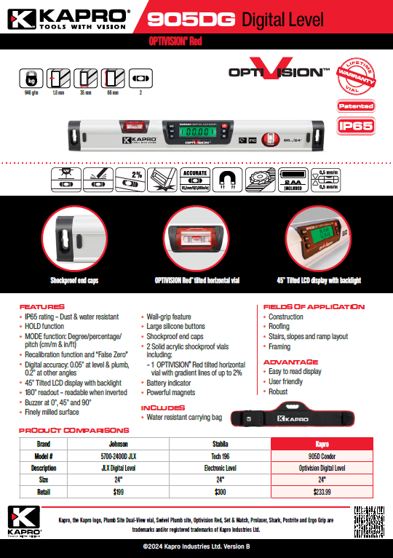
905DG DIGITAL CONDOR™
BOX LEVELS

Slide 16
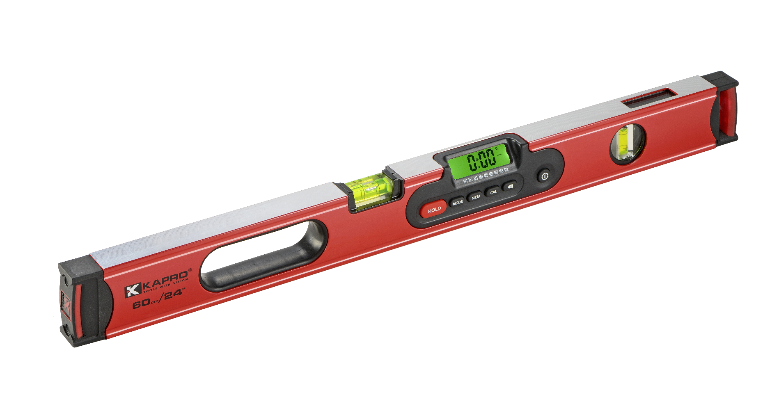
985D DIGIMAN
Professional Magnetic Digital Level
DIGITAL LEVELS
Type | BOX+ DIGITAL
Accuracy | ±0.5mm/m (±0.0005 in/in)
Digital accuracy | <0.1° at level & plumb <0.2° at other angles
Length | 10″| 24″ | 48″
Vials | 2 vials – 1 Horizontal + 1 Plumb Site®

Slide 17
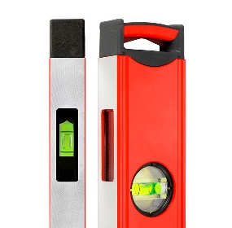
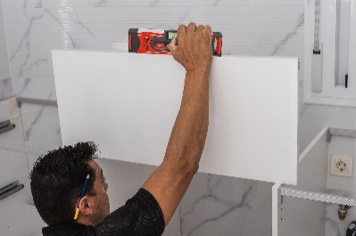
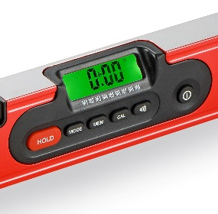
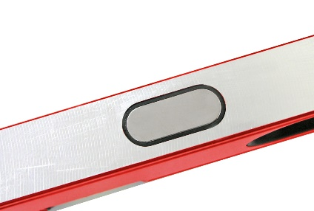
985D DIGIMAN
Professional Magnetic Digital Level
Digital accuracy:
0.05° at level & plumb
0.2° at other angles
Plumb Site® Dual-View™ vial
Tiling
DIGITAL LEVELS
Masonry
Rare-Earth magnets
Framing

Slide 18
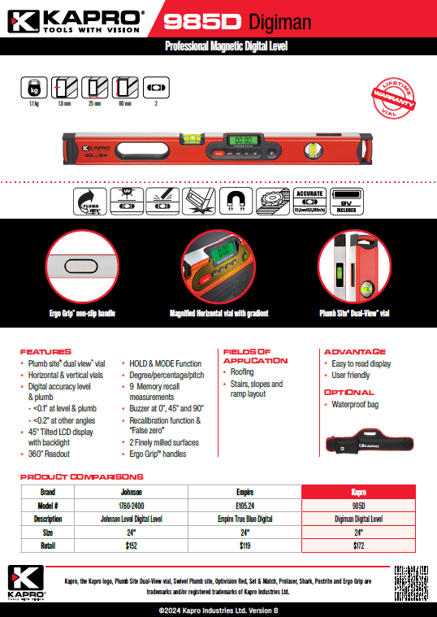
985D DIGIMAN
DIGITAL LEVELS

Slide 19
SPECIALTY LEVELS

Slide 20
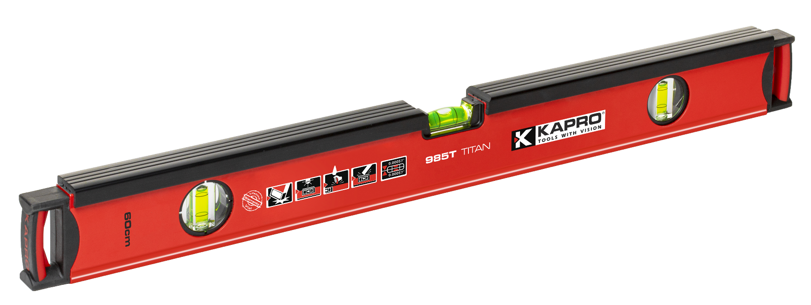
985T TITAN™
SPECIALTY LEVELS
Type | BOX
Accuracy | ±0.5mm/m (±0.0005 in/in)
Length | 24″| 48″
Vials | 3 vials – 1 Horizontal + 2 Vertical

Slide 21
985T TITAN™
Top edge high impact polymeric overlay
for absorbing hammer and mallet blows
Tilling
Magnified horizontal vial with gradient lines up to 2%
SPECIALTY LEVELS
Masonry
2 vertical vials
Framing

Slide 23
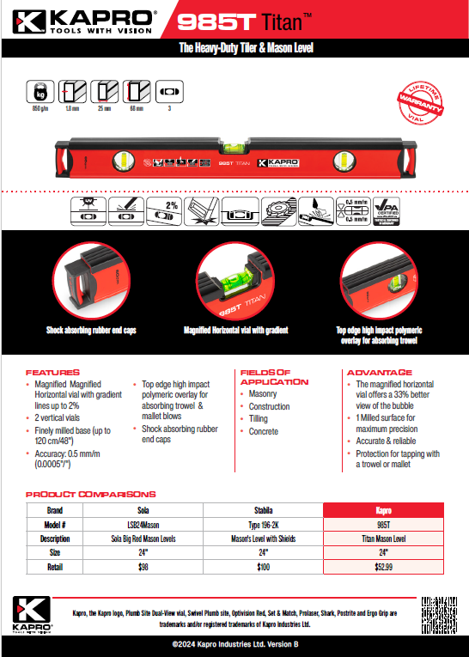
985T TITAN™
SPECIALTY LEVELS

Slide 24
770 EXODUS™
SPECIALTY LEVELS
Type | BOX
Accuracy | ±0.5mm/m (±0.0005 in/in)
Length | | 32″ | 48″ |
Vials | 3 vials – 1 Horizontal + 1 Vertical + 1 of 45°

Slide 25
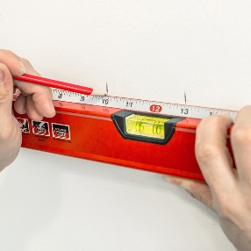
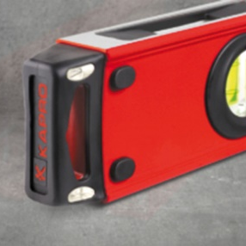
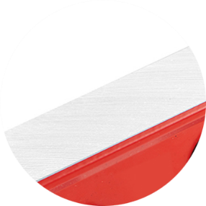
770 EXODUS™
Precise & Accurate Results
Precise Straightedge Ruler.
SPECIALTY LEVELS
Shock Absorbing
Rubber End-Caps
Tiling
Finely Milled Surface
Plumbing

Slide 26
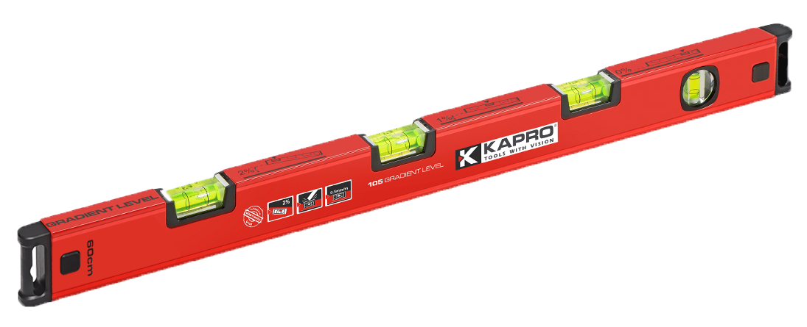
105 TOPGRADE™
Gradient Level Up to 2%
SPECIALTY LEVELS
Type | BOX
Accuracy | ±0.5mm/m (±0.0005 in/in)
Length | 24″ | 48″
Vials | 3-6 vials – 3-5 Horizontal + 1 Vertical

Slide 27
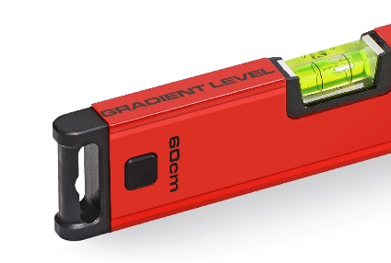
105 TOPGRADE™
Gradient Level Up to 2%
Shock-Absorbing Rubber End-Caps
Tilling
3-5 Horizontal Vials
SPECIALTY LEVELS
Plumbing
Milled Surface
Masonry

Slide 28
TOREPEDO LEVELS

Slide 29
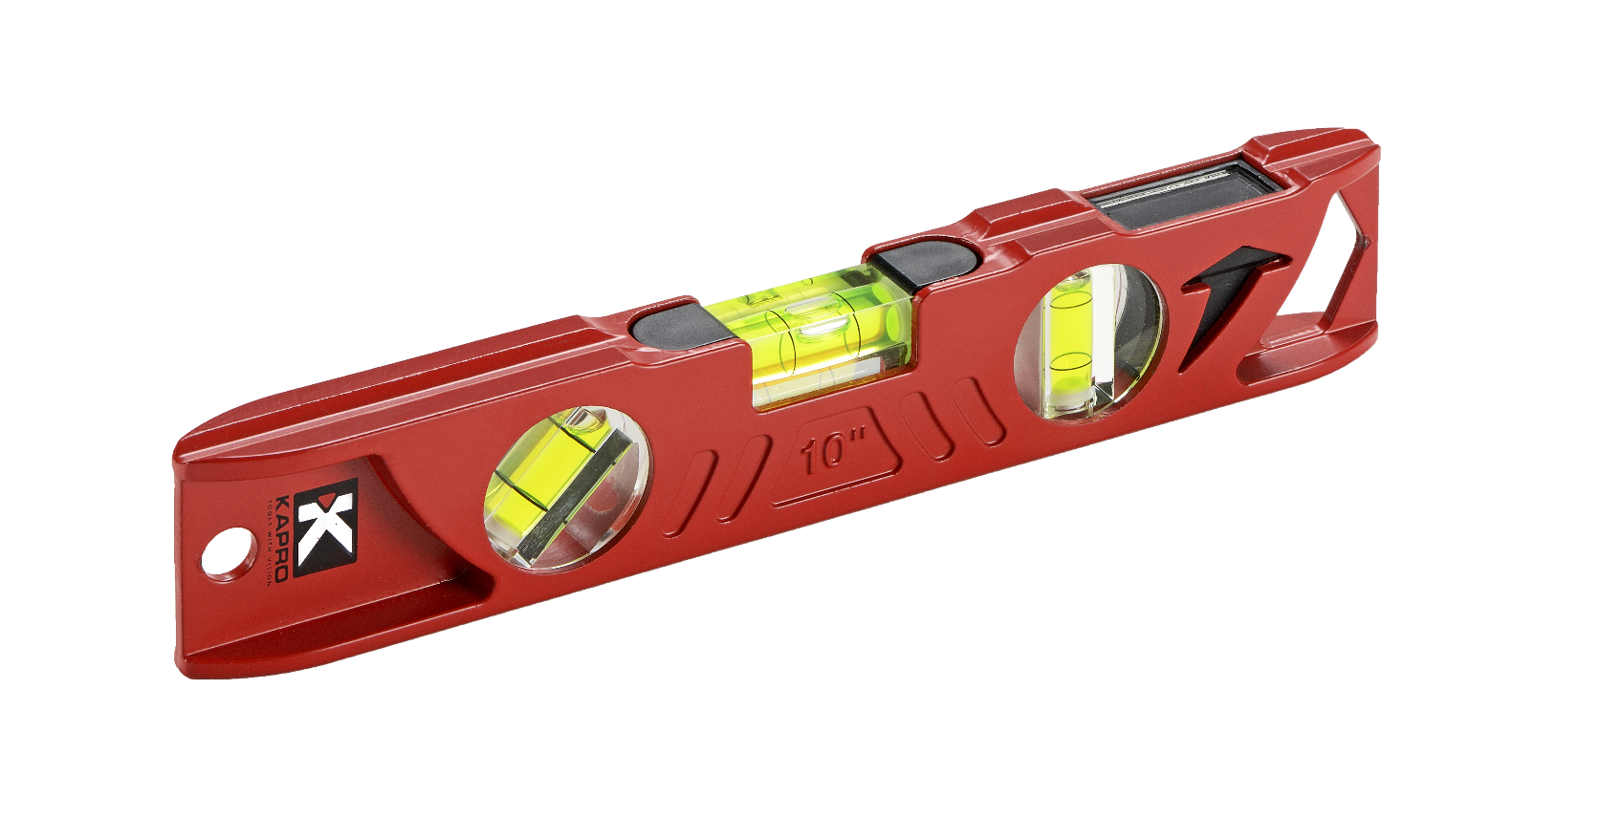
923 CAST TORPEDO LEVEL
TOOLBOX LEVELS
Type | TOOLBOX
Accuracy | ±0.5 mm/m (±0.0005 in/in)
Length | 10”
Vials | 3 vials – 1 Plumb Site® + 1 Epoxy locked horizontal + 1 45°

Slide 30
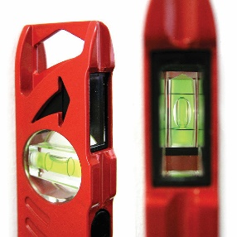
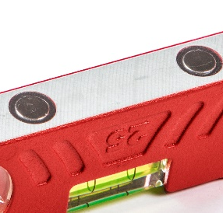
923 CAST TORPEDO LEVEL
Plumb Site® Dual-View™ vial
Drywall installations
TOOLBOX LEVELS
V-Groove
Tiling
Milled Base With Rare-Earth Magnets
Plumbing

Slide 31
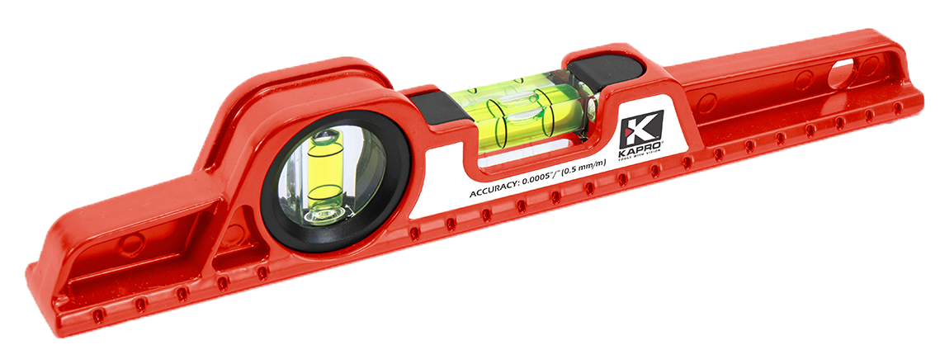
724 CAST TORPEDO LEVEL
TOOLBOX LEVELS
Type | CUST
Accuracy | ±0.5mm/m (±0.0005 in/in)
Length | 10”
Vials | 2 vials – 1 Horizontal + 1 Vertical

Slide 32
724 CAST TORPEDO LEVEL
Solid Acrylic Shockproof Vials
Drywall installations
V-Groove Base for Pipe & Conduit Leveling
TOOLBOX LEVELS
Tiling
Milled Surface
Woodwork

Slide 33
SETS

Slide 34
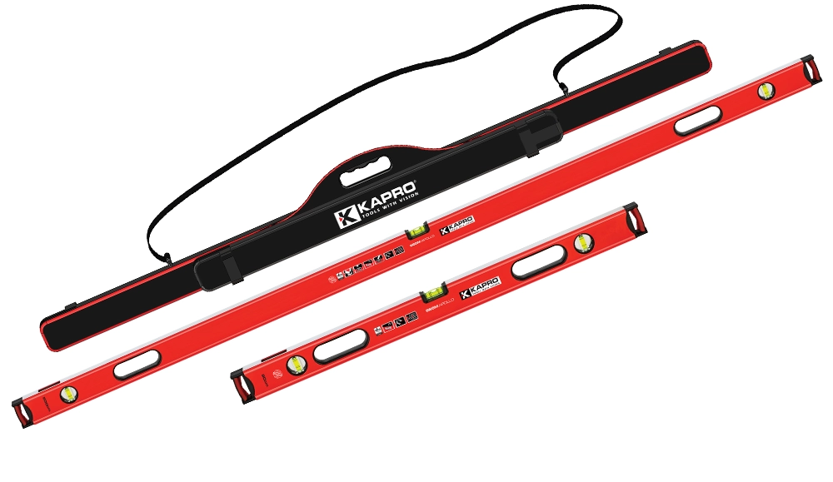
Kapro Classic Jamber Set
Multi Level Bag
LEVEL SETS
78” Apollo Box Level
32” Apollo Box Level

Slide 35
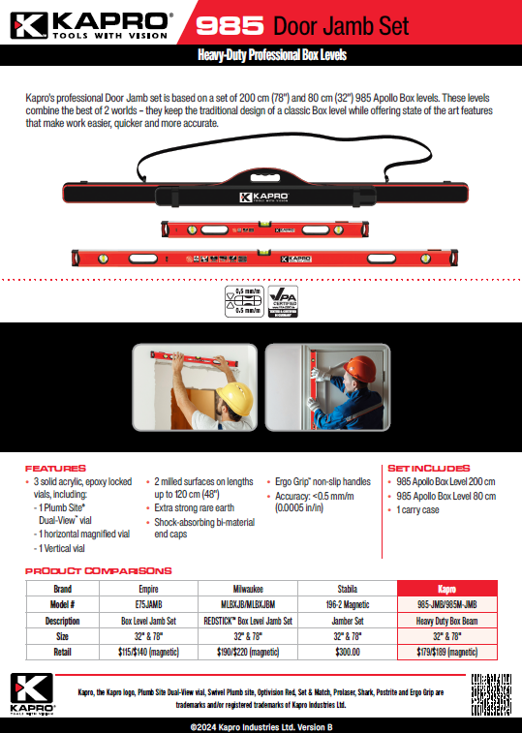
Kapro Classic Jamber Set
LEVEL SETS

Slide 36
Kapro 4 Piece Pro Contractors Level Set
Multi Level Bag
LEVEL SETS
24” Apollo Box Level
48” Apollo Box Level
10” Cast Toolbox Level

Slide 37
Kapro Apollo 48” And 16” Level Set
48” Apollo Level
LEVEL SETS
16” Apollo Level

Slide 38
Kapro Apollo Titan Level Sets
24” Apollo Level
LEVEL SETS
10” Cast Toolbox Level
48” Apollo Level
10” Cast Toolbox Level

Slide 39
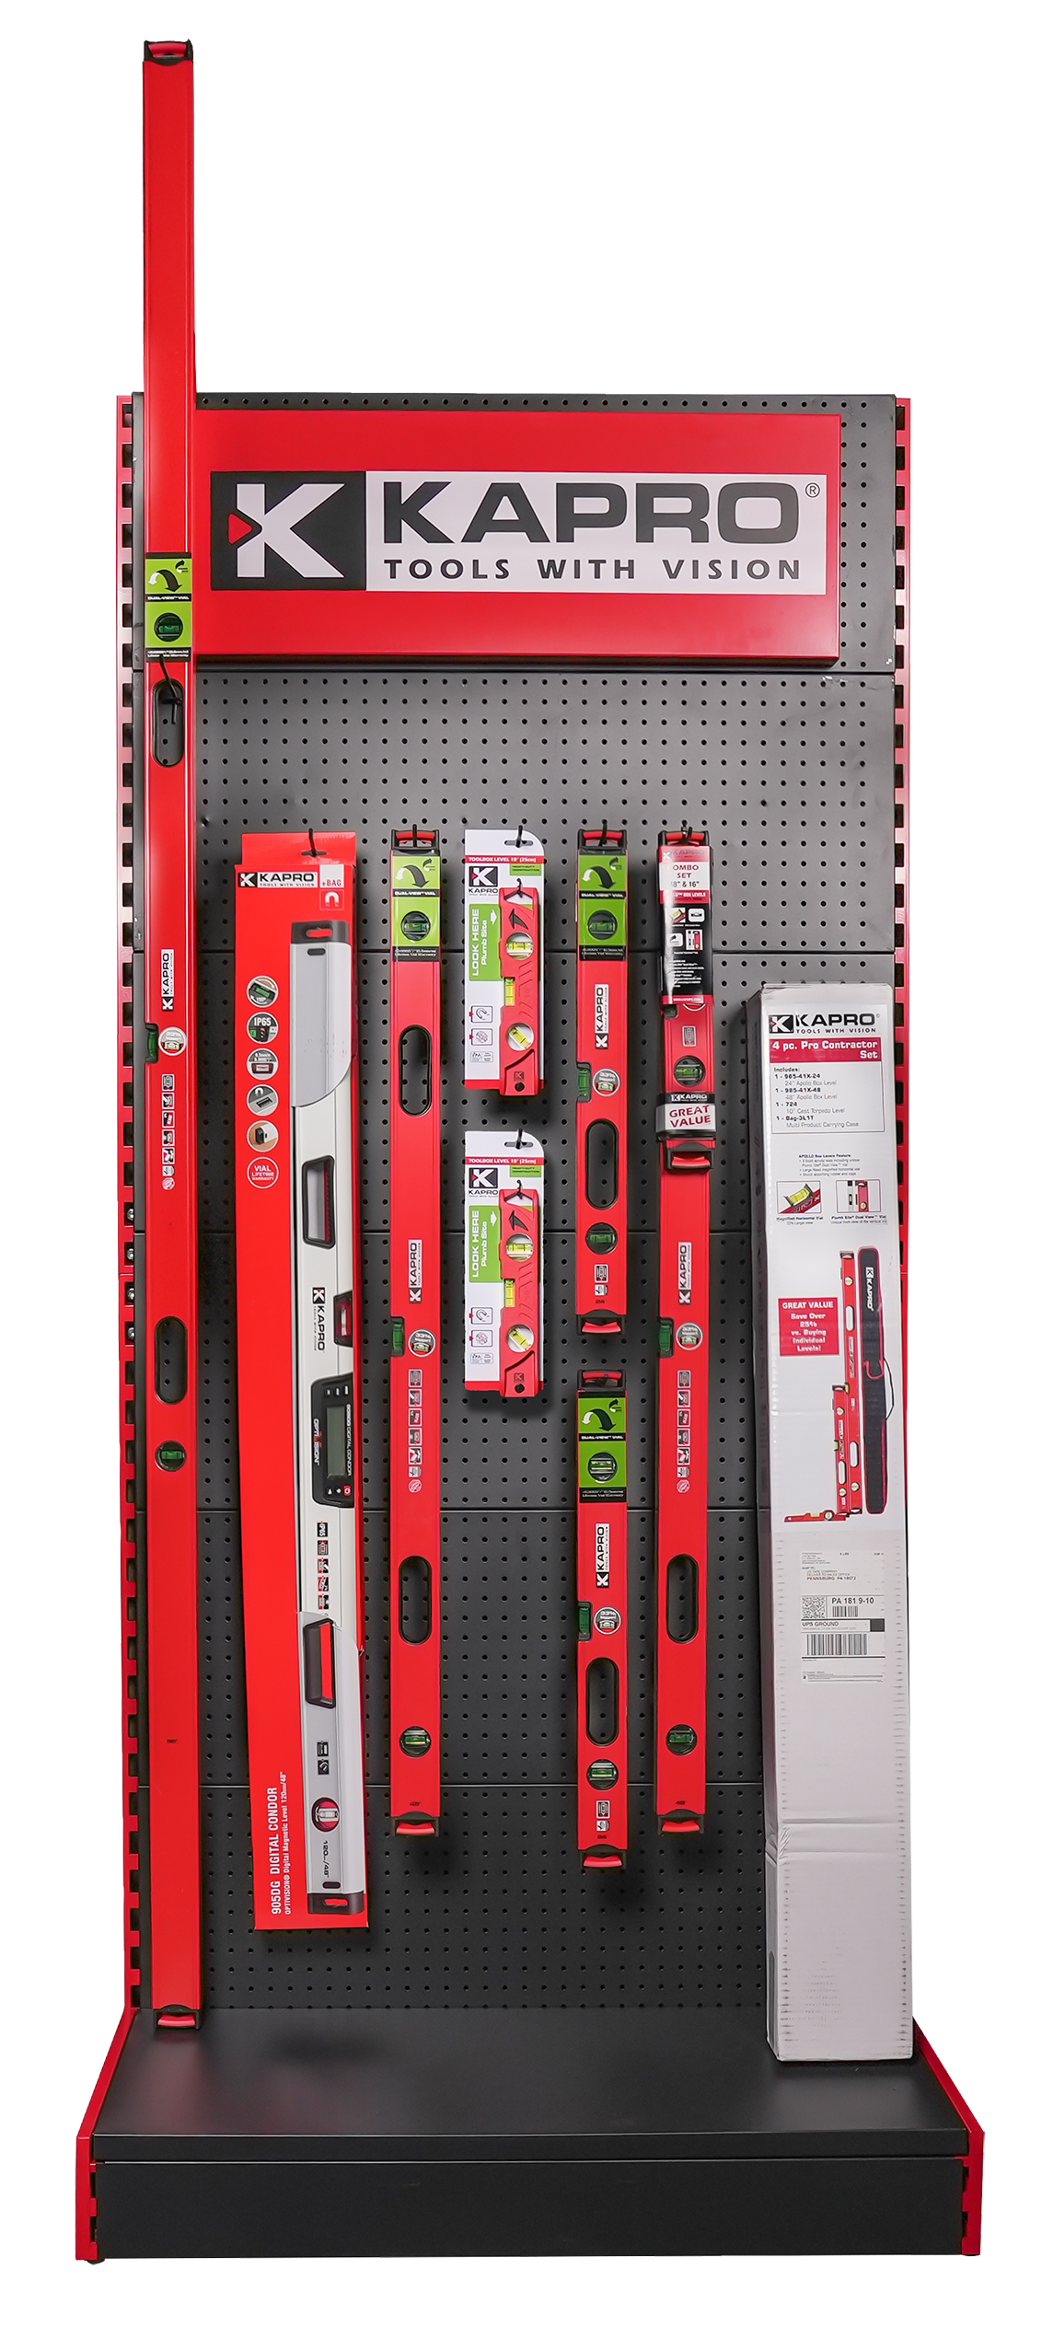
Kapro Level Displays
Trifecta Display
LEVEL SETS
Kapro 7-piece Core Assortment

Slide 40
LASER LEVELS

Slide 41
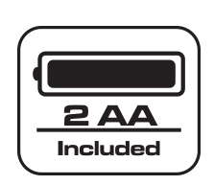
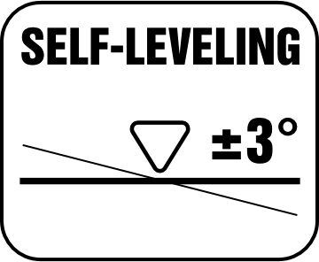
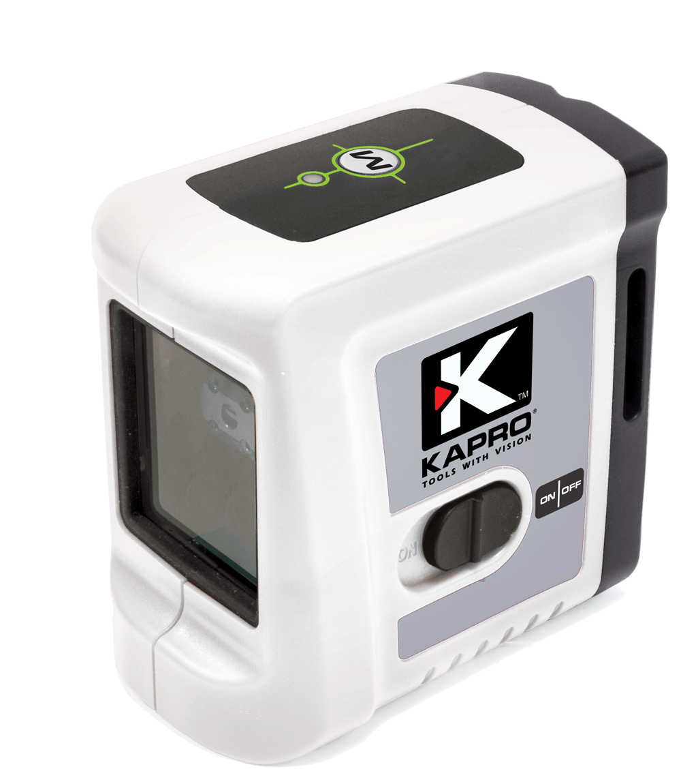
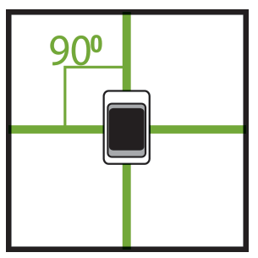
862G PROLASER® CROSS LINE
LINE LEVEL
Laser type | PENDULUM SELF- LEVELING
Accuracy | ±0.4mm/m (±0.0004 in/in)
Self-leveling | ±3˚
Number of beams | Vertical and horizontal cross beams
Range | 65ft

Slide 42
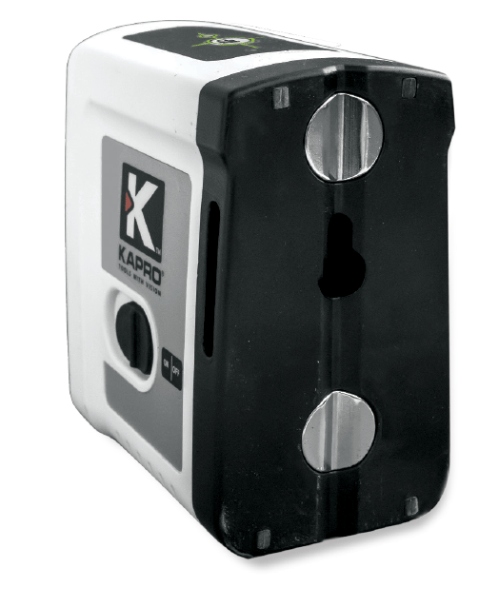
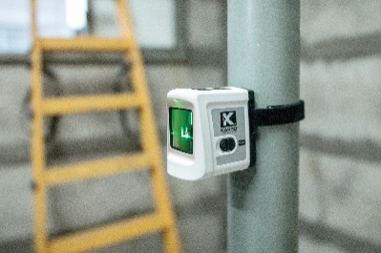
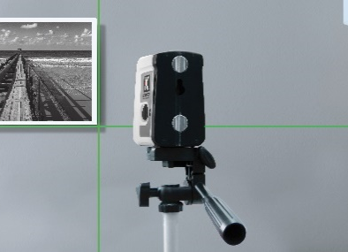
862G PROLASER® CROSS LINE
Hanging Hole
Electrical
Self-levels in automatic mode
LINE LEVEL
Tiling
V-Groove
Visual warning (blinking) when the laser is out of leveling range
R.E magnets
DIY

Slide 43
862G PROLASER® CROSS LINE
LINE LEVEL

Slide 44
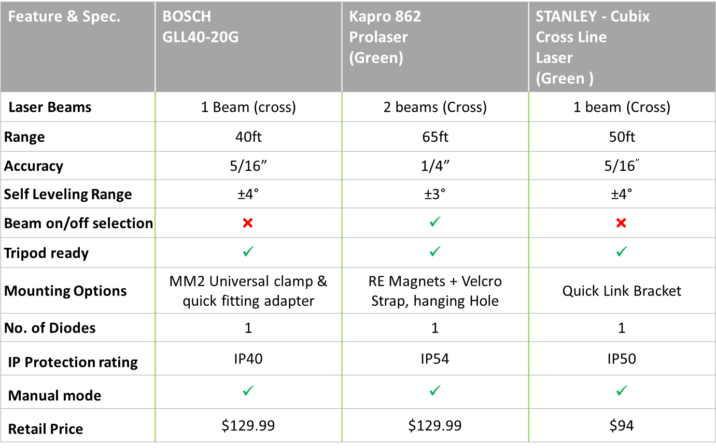
862G PROLASER® CROSS LINE
LINE LEVEL

Slide 45
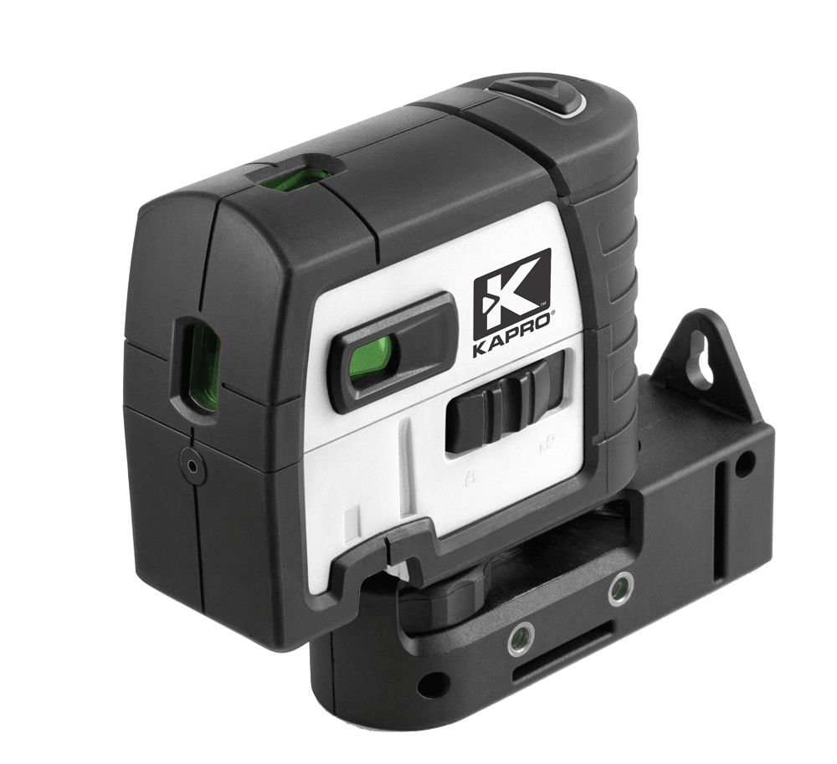
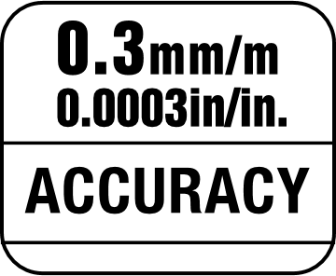
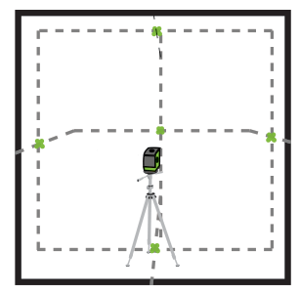
896G PROLASER® 5-DOT
DOT LEVEL
Laser type | DOT LEVEL
Accuracy | ±0.3 mm/m (±0.0003 In/In)
Self-leveling | ±3.5°
Number of beams | 3x Level Dots at 90˚ Plumb dot up & down
Range | 65ft
Range with detector | 165ft

Slide 46
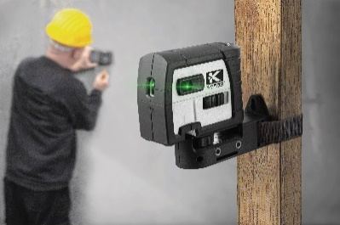
896G PROLASER® 5-DOT
Electrical
Laser Plumb Dot Up
DOT LEVEL
Hanging Hole
Laser Dot
Masonry
Laser Plumb Dot Down
Drywall Installation

Slide 47
896G PROLASER® 5-DOT
DOT LEVEL

Slide 48
896G PROLASER® 5-DOT
DOT LEVEL

Slide 49
873G PROLASER® VECTOR
LINE LEVEL
Laser type | PENDULUM SELF- LEVELING
Accuracy | ±0.2mm/m (±0.0002 in/in)
Self-leveling | ±3˚
Number of beams | 1x Horizontal 1x Vertical
Range | 100 ft
Range with detector | 200 ft

Slide 50
873G PROLASER® VECTOR
Vertical Windows
Electrical
LINE LEVEL
Horizontal Window
Tiling
Strong Folding Legs
Anti-Slip Grips
Masonry

Slide 51
873G PROLASER® VECTOR
LINE LEVEL

Slide 52
873G PROLASER® VECTOR
LINE LEVEL

Slide 53
962G PROLASER® MULTIBEAM ORBITAL
LINE LEVEL
Laser type | PENDULUM SELF- LEVELING
Accuracy | ±0.3mm/m (±0.0003 in/in)
Self-leveling | ±3˚
Number of beams | 1x Horizontal Orbital Beam 1x Vertical Beam Plumb dot up & down
Range | 100 ft
Range with detector | 200 ft

Slide 54
962G PROLASER® MULTIBEAM ORBITAL
Horizontal Laser Beam Window 360˚
Electrical
Vertical Laser Output Window
LINE LEVEL
Plumb Up
Woodwork
Plumb Down
Drywall Installation

Slide 55
962G PROLASER® MULTIBEAM ORBITAL
LINE LEVEL

Slide 56
962G PROLASER® MULTIBEAM ORBITAL
LINE LEVEL

Slide 57
883G PROLASER® 3D ALL-LINES
LINE LEVEL
Laser type | BEAM LASER
Accuracy | ±0.2mm/m (±0.0002 in/in)
Self-leveling | ±2.5˚
Number of beams | 1x Horizontal 1x Forward Vertical Beam 1x Forward Vertical Beam
Range | 100ft
Range with detector | 230ft

Slide 58
883G PROLASER® 3D ALL-LINES
Keypad
Horizontal Laser Beam Window 360˚
Electrical
Grip Area
LINE LEVEL
Forward Vertical Laser Beam Window 360˚
Tiling
Side Vertical Laser Beam Window 360˚
Drywall Installation

Slide 59
883G PROLASER® 3D ALL-LINES
LINE LEVEL

Slide 60
883G PROLASER® 3D ALL-LINES
LINE LEVEL

Slide 61
8991G PROLASER® ELECTROTA®
ROTARY LINE
Laser type | ROTERY LINE
Accuracy | ±0.1mm/m (±0.0001 in/in)
Self-leveling | ±5˚
Number of beams | 1x Green Rotating Beam Plumb dot up & down
Range | 165ft
Range with detector | 980ft

Slide 62
8991G PROLASER® ELECTROTA®
Protective Shock Absorbing Cover
Five variable speeds (0, 60,120, 300, 600 rpm)
Electrical
360° rotation generates a horizontal or vertical level plane
ROTARY LINE
Drywall Installation
Rugged design with protective handles
Masonry

Slide 63
8991G PROLASER® ELECTROTA®
ROTARY LINE

Slide 64
8991G PROLASER® ELECTROTA®
ROTARY LINE

Slide 65
8991G PROLASER KIT
MSRP $1,250.00
ROTARY LINE

Slide 66
LAYOUT, MARKING
& MEASURING

Slide 67
317 ADJUSTABLE T-SQUARE
Aluminum Profile
Sliding Head Adjusts To Any Angle
Strong Screw Lock
Angle Markings
SQUARES & ANGLES
Folds For Easy Storage
ABS End Caps With Ledge
48″ | Available size
cm/ Inch | Units

Slide 68
317 ADJUSTABLE T-SQUARE
Aluminum Profile
SQUARES & ANGLES

Slide 69
325 MAGNETIC LOCK COMBINATION SQUARE
Easy-to-Read Vial
Precise & Accurate Results
Magnetic Mechanism
SQUARES & ANGLES
Angle markings
Permanently Etched Ruler Markings (cm or In)
12″ | Available size
cm/ Inch | Units

Slide 71
353 LEDGE-IT SQUARE
Hanging Hole
Precise & Accurate Results
SQUARES & ANGLES
Aluminum Cast Handle
Angle Markings
Ledge Support
8’’ | 10’’ | 12’’ | Available size
Inch | Units
10° | 15° | 22.5° | 30°| 45° | 50° | 60° | Angler markings
Retractable Metal Ledge Support

Slide 73
THANK YOU!

